Slide 1



GLOBAL TERRORISM DASHBOARD
View in Power BI
or
View in Power BI (no need to login)
Last data refresh:
10/10/2022 2:39:53 PM UTC
Downloaded at:
10/10/2022 2:53:35 PM UTC

Slide 2
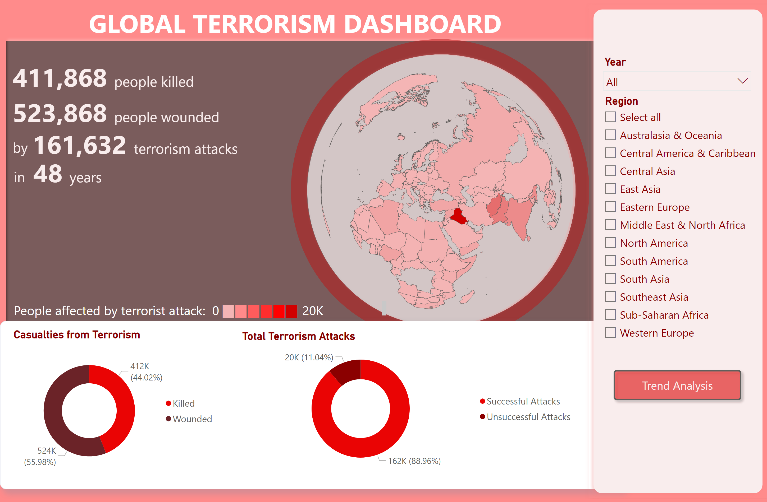
Main Page
Notes:
shape
No alt text provided
shapeMap
No alt text provided
shape
No alt text provided
slicer
No alt text provided
textbox
No alt text provided
shape
No alt text provided
textbox
No alt text provided
textbox
No alt text provided
textbox
No alt text provided
textbox
No alt text provided
textbox
No alt text provided
textbox
No alt text provided
textbox
No alt text provided
shape
No alt text provided
shape
No alt text provided
slicer
No alt text provided
Casualties from Terrorism
No alt text provided
Total Terrorism Attacks
No alt text provided
actionButton
No alt text provided

Slide 3
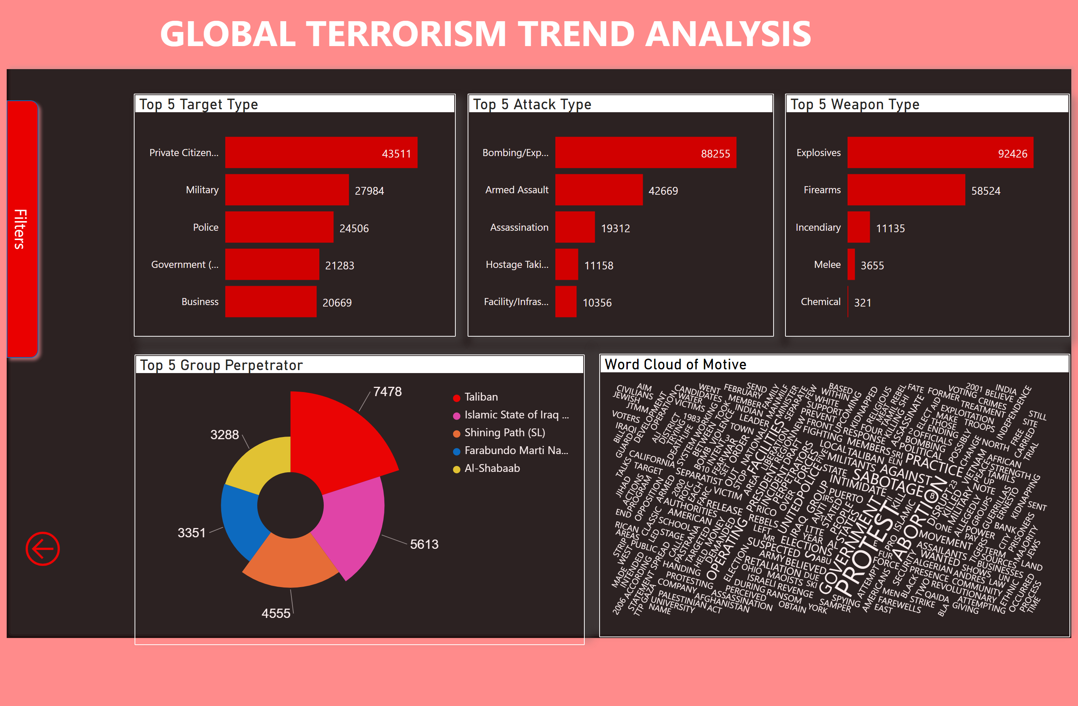
Trend Analysis
Notes:
textbox
No alt text provided
shape
No alt text provided
Top 5 Target Type
No alt text provided
Top 5 Attack Type
No alt text provided
Top 5 Weapon Type
No alt text provided
Top 5 Group Perpetrator
No alt text provided
Word Cloud of Motive
No alt text provided
slicer
No alt text provided
slicer
No alt text provided
slicer
No alt text provided
actionButton
No alt text provided
textbox
No alt text provided
shape
No alt text provided
slicer_showbox
No alt text provided
actionButton
No alt text provided

